Slide 1

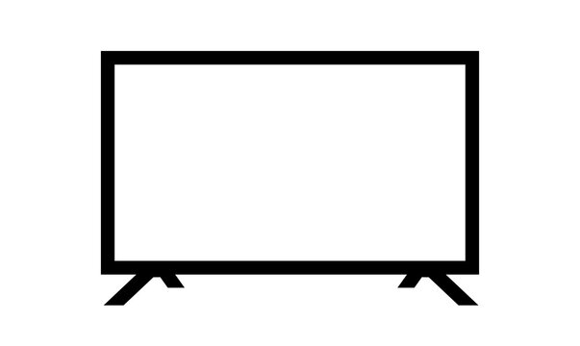
Smart TV
Using python and yocto
Name: Seif El Deen Sameh

Slide 2
Contents
01
02
03
Introduction
Objectives
Raspberry pi
04
05
06
07
Python
Yocto
Implementation
Conclusion

Slide 3
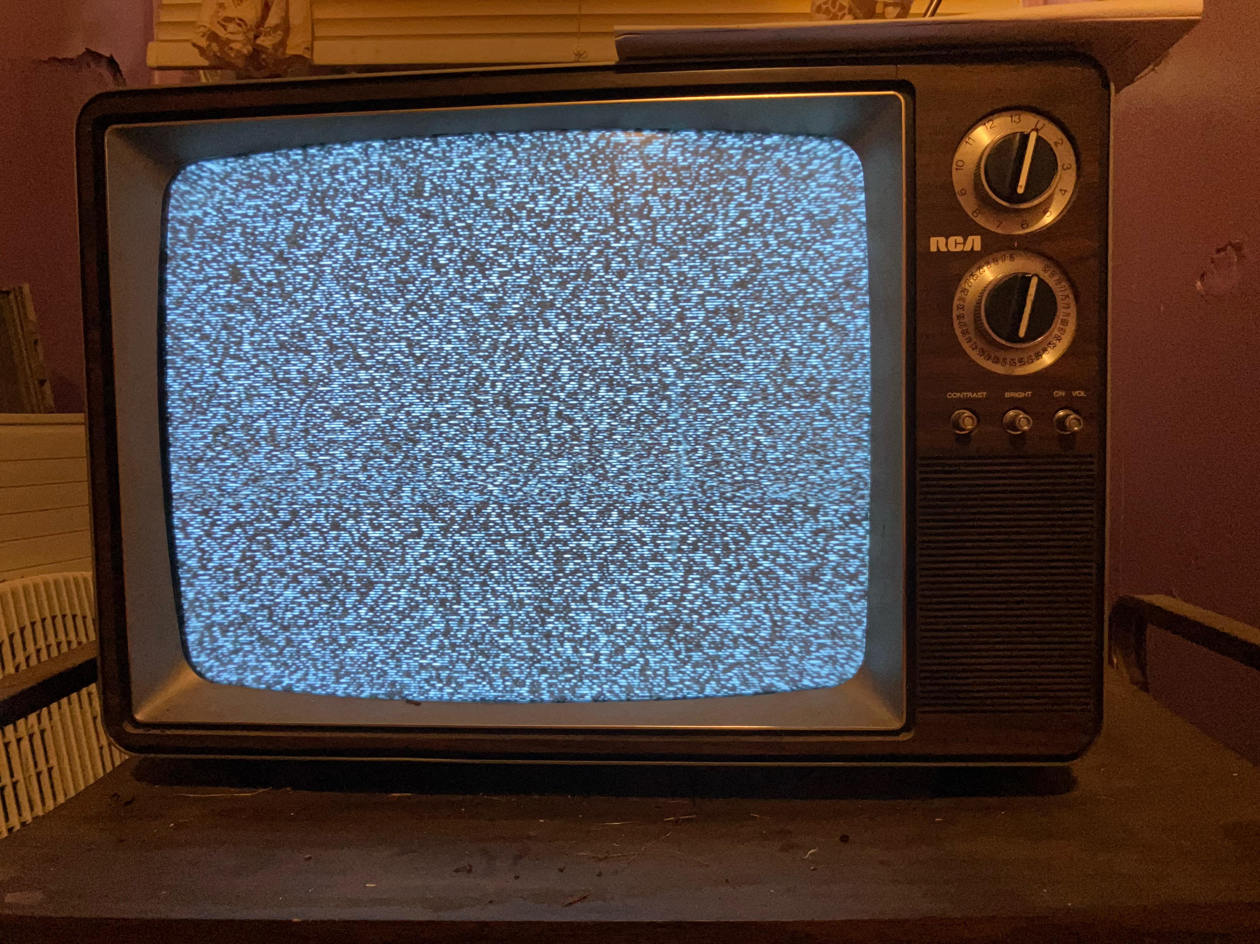
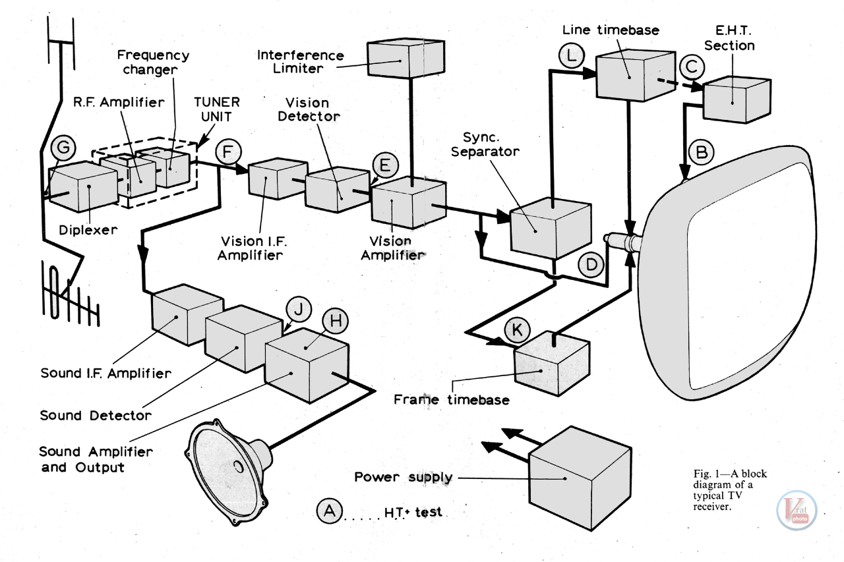
01
Introduction

Slide 4
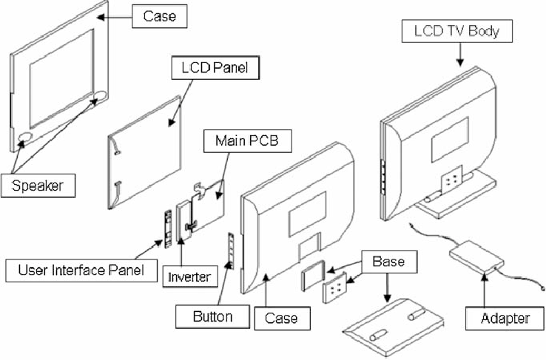
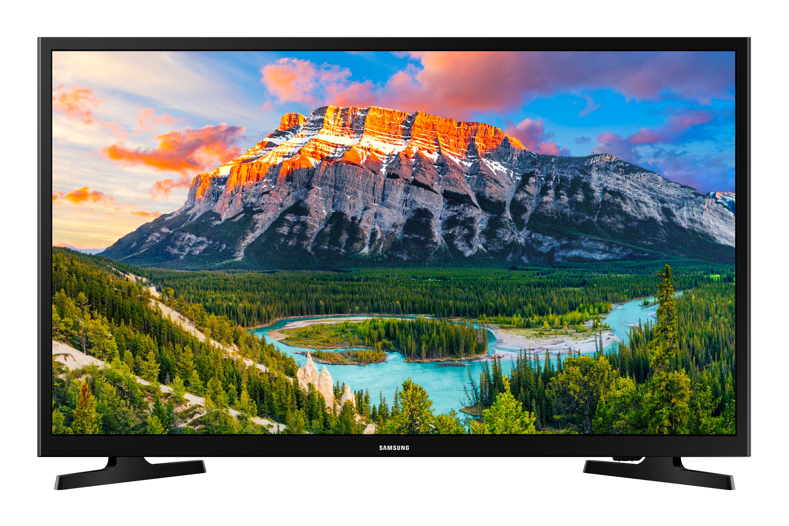
01
Introduction

Slide 5
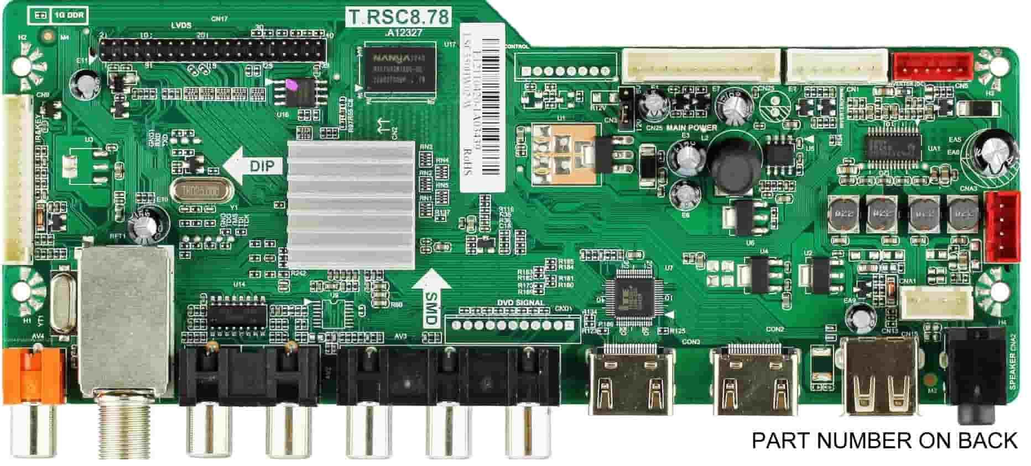
01
Introduction

Slide 6
01
Introduction
Project’s elements:
Raspberry pi
Yocto
Python
Screen

Slide 7
02
Objectives
This project aims to make a TV that:
Play audio and video files from it’s internal storage
Browse the internet
Navigate external hard drives
Connect to local TV network

Slide 8
02
Objectives
Briefly explain how tv works
Give detailed and simplified information regarding project’s elements
Discuss the project’s workflow and project’s current progress

Slide 9
03
Raspberry pi
Raspberry Pi are a series of single-board computers made by the Raspberry Pi Foundation
Raspberry Pi was made to educate people in computing and create easier access to computing education.
Raspberry Pi is used to
Learn programming skills
Build hardware projects
Industrial applications

Slide 10
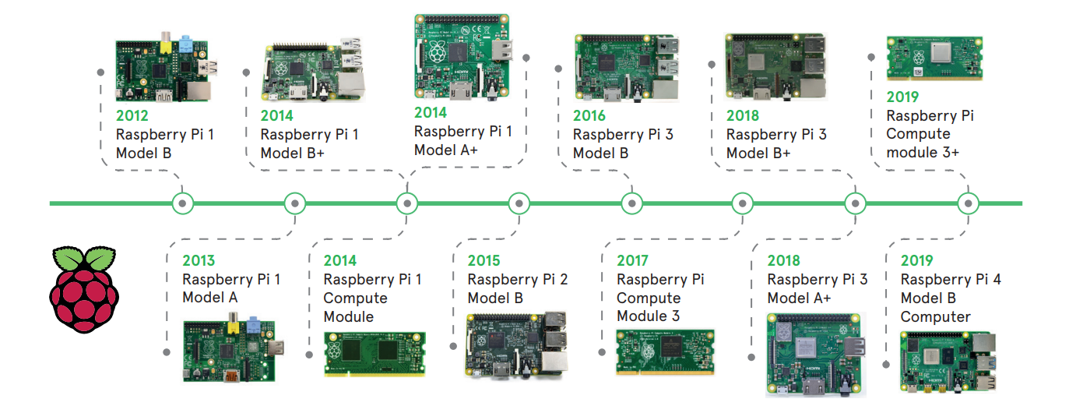
03
Raspberry pi

Slide 11
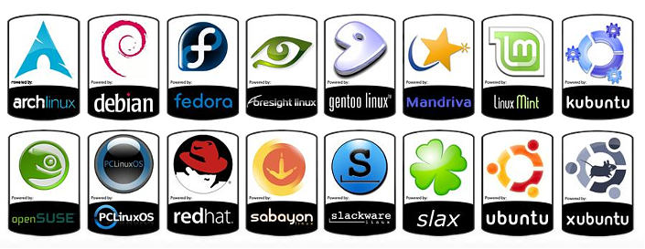
03
Raspberry pi
Raspberry Pi uses a special version of linux as an operating system

Slide 12
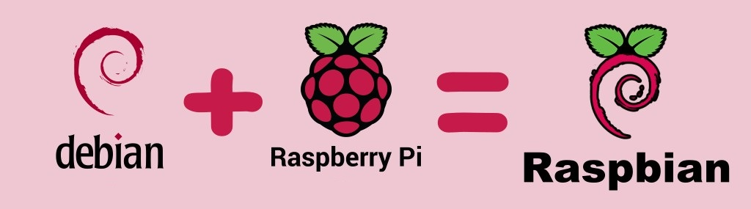
03
Raspberry pi
Raspberry Pi uses a special version of linux as an operating system

Slide 13
04
Python
Python is a high-level, general-purpose programming language
Python’s design philosophy emphasizes code readability
Python is a cross platform language aka works on different platforms
Python is used to
Software development
Mathematics
System scripting

Slide 14
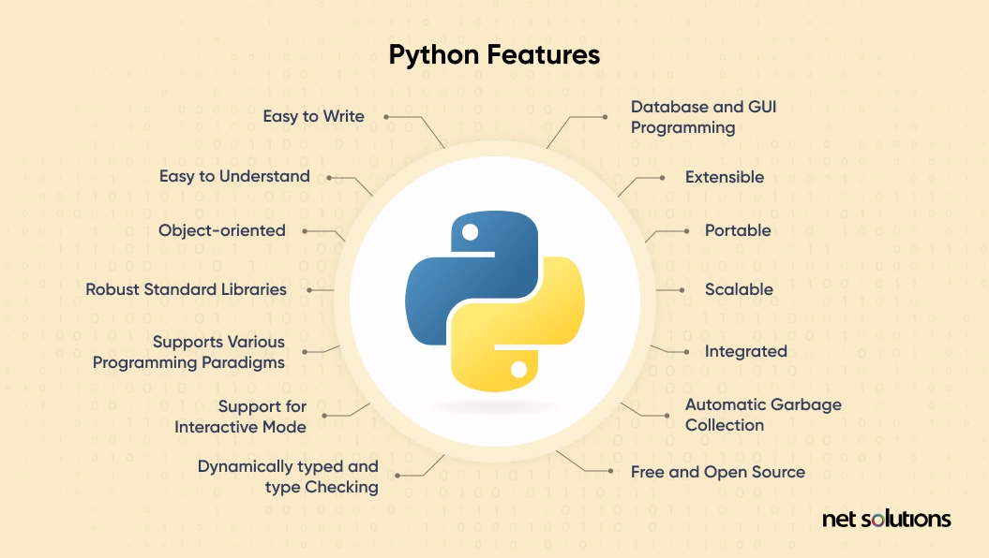
04
Python

Slide 15
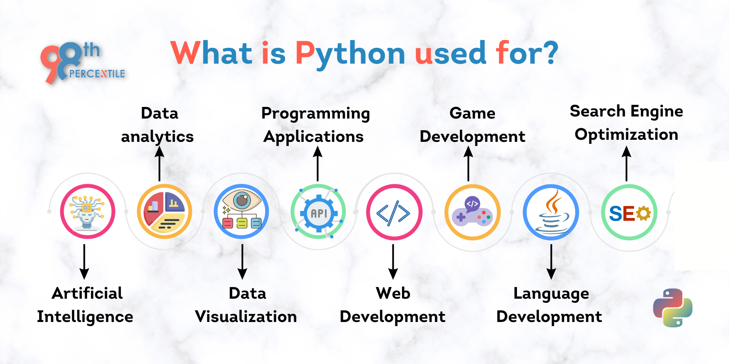
04
Python

Slide 16
05
Yocto
The Yocto Project is a Linux Foundation collaborative open source project
The Yocto Project goal is to produce tools and processes that enable the creation of Linux distributions for embedded and IoT software

Slide 17
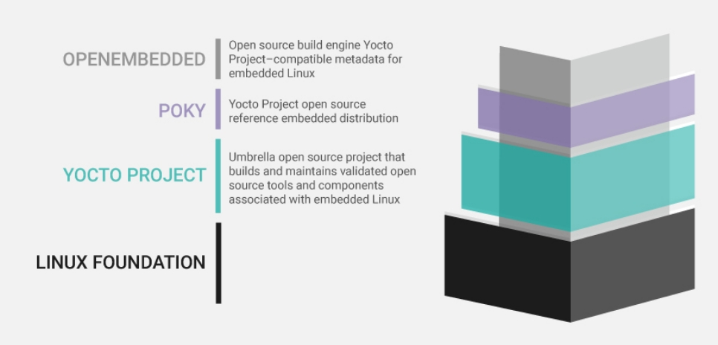
05
Yocto

Slide 18
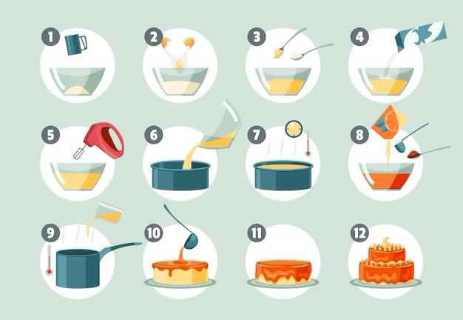
05
Yocto
Project Yocto operates like baking a pie where:
poky is the pie making instructions
bitbake is oven that cooks the pie
open embedded is the pie’s ingedents

Slide 19
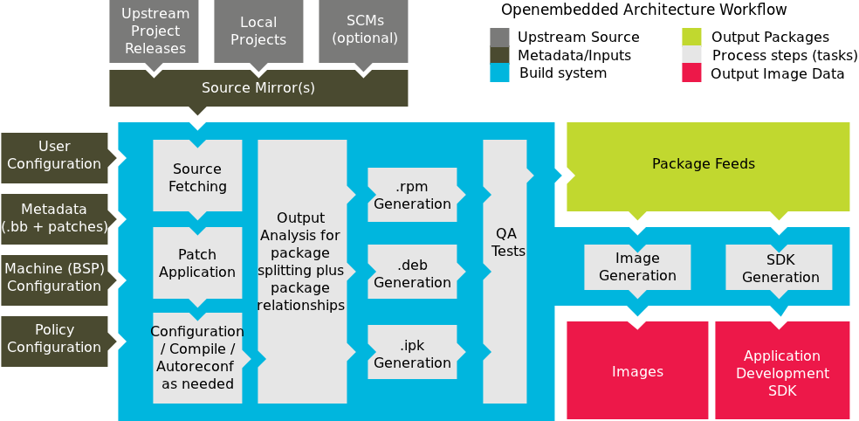
05
Yocto

Slide 20
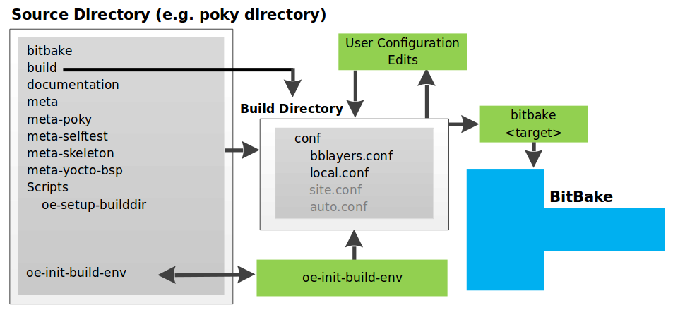
05
Yocto

Slide 21
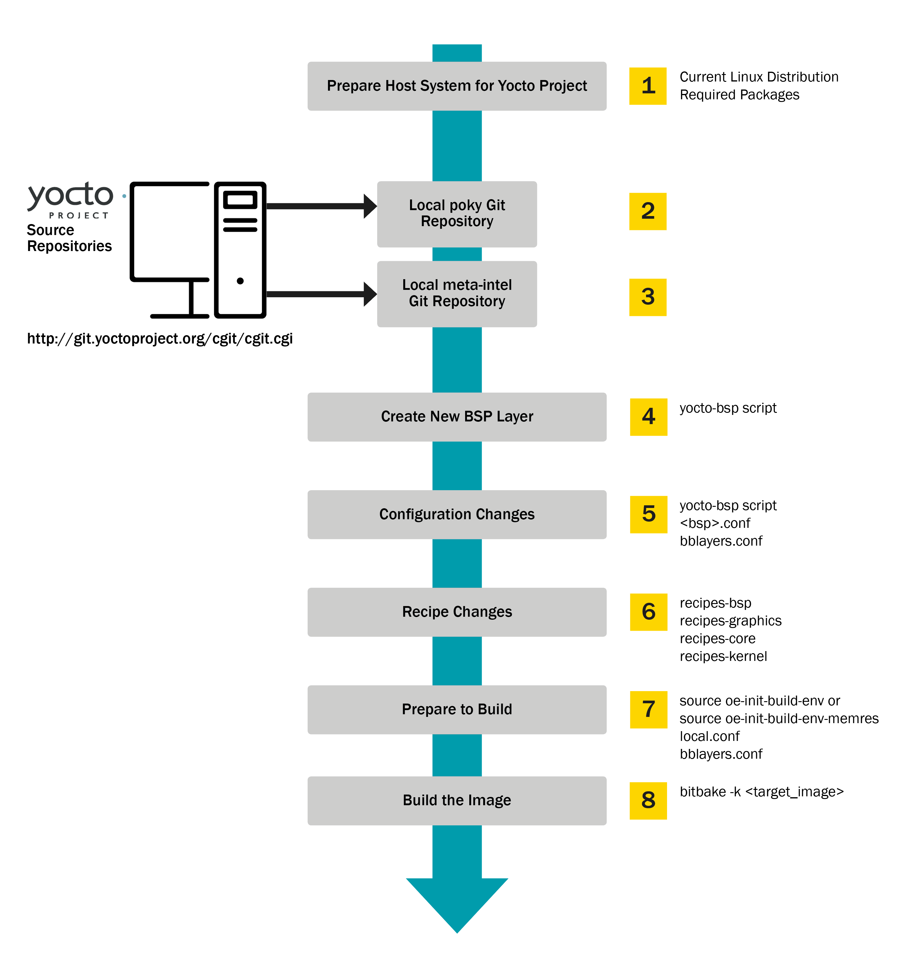
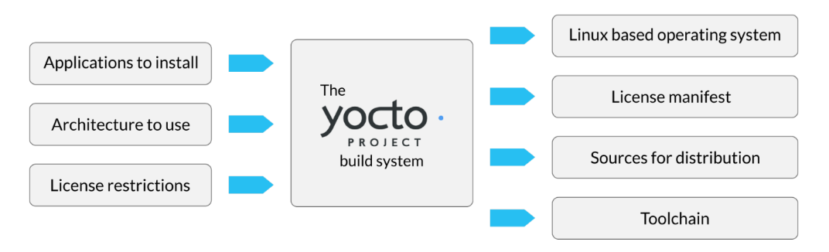
05
Yocto

Slide 22
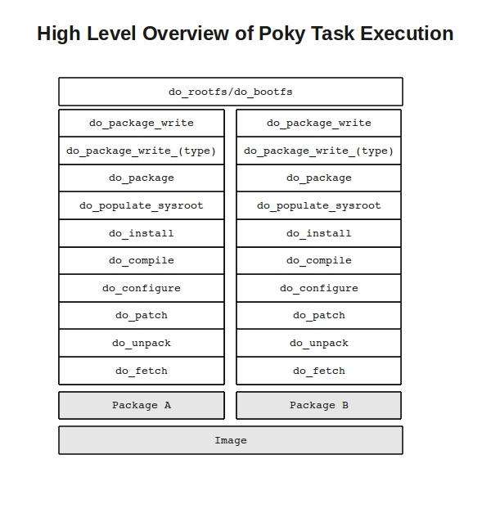
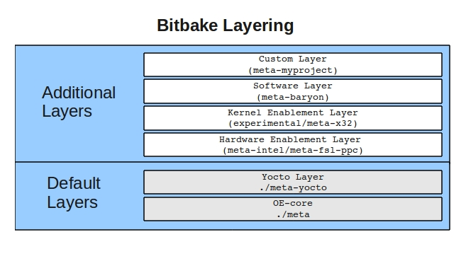
05
Yocto

Slide 23
06
Implementation
Hardware Used
Raspberry pi B
Raspberry pi 3B
LCD HDMI 7 inch 1024x600 Touch Screen

Slide 24
06
Implementation
Software Used
Ubuntu 22.06
Python 3.10
pyQt5 ( a GUI python library )
Yocto kirkstone

Slide 25
06
Implementation
Videos to display
2025-02-18_01-52-54.mkv
2025-02-18_01-33-25.mkv
WhatsApp Video 2025-02-18 at 07.20.27_d5593c93.mp4
Note: videos where included however in order to be upladed they had to sperated from the powerpoint

Slide 26
06
Conclusion
Future Work
Browse the internet
Navigate external hard drives
Connect to local TV network
Reduce the system’s cost
provide resoultion options

Slide 27
THE END
Thanks of listening

